Slide 1
Restaurant Analysis

Slide 2
Objective:
The main purpose of our restaurant data analysis is to find meaning in data so that the derived knowledge can be used to make informed decisions.
Benefits:
Gives better insights.
Helps in easy flow.

Slide 3
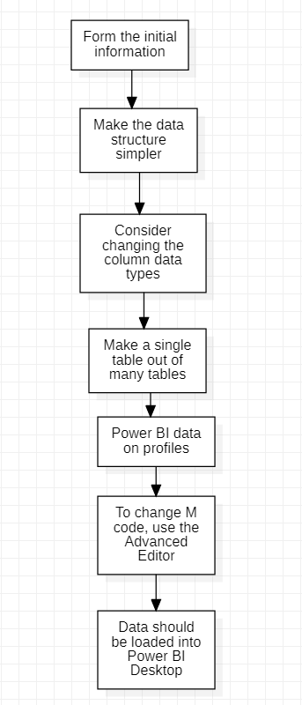

Slide 4
1. Form the initial information
You can shape (alter) your imported data using Power Query Editor in Power BI Desktop. Renaming columns or tables, turning text to numbers, eliminating rows, setting the first row as headers, and much more are all possible. It's critical to structure your data so that it matches your requirements and can be used in reports.
2. Make the data structure simpler.
When you import data into Power BI Desktop from numerous sources, the data keeps its specified table and column names. You could wish to rename some of these items to make them more consistent, easier to work with, and meaningful to users. To make these name changes and simplify your data structure, use Power Query Editor in Power BI Desktop.

Slide 5
3. Consider changing the column data types.
Before loading data into a Power BI data model, it's a good idea to evaluate the column data types in Power Query Editor. You can modify a data type if you find it to be erroneous. You might also want to format the values in a column and modify the column's default summary.
4. Make a single table out of many tables.
Combining queries is useful since it allows you to append or merge data from several tables or searches. In the following situations, you can combine tables into a single table:
There are too many tables, making it difficult to manage a complex data model.
Several tables serve the same purpose.
Only one or two columns in a table can be moved to another table.
In a custom column, you wish to combine columns from multiple tables.

Slide 6
5. Power BI data on profiles
Profiling data entails finding abnormalities, inspecting and improving the underlying data structures, and querying data statistics like row counts, value distributions, minimum and maximum values, averages, and so on. This notion is significant because it helps you to structure and arrange data in such a way that dealing with it and determining its distribution is simple, making your job of working with data on the front end to create report elements nearly painless.

Slide 7
6. To change M code, use the Advanced Editor.
You generate a step in the Power Query process every time you shape data in Power Query. Where it makes sense, such steps can be reordered, eliminated, or adjusted. Although you probably generated each cleaning step using the graphical interface, Power Query uses the M language behind the scenes. Using the Power Query Advanced Editor, you may read the combined steps. The M programming language is always open for direct reading and modification. It is not necessary to use M code in order to use Power Query. Although you will rarely need to create M code, it can be handy.
7. Data should be loaded into Power BI Desktop.
Select Open report and then Browse reports from the File tab.

Slide 8
FAQ
What techniques were you using for data pre-processing?
Removing unwanted attributes
Visualizing relation of independent variables with each other and output variables
Checking and changing Distribution of continuous values
Removing outliers
Cleaning data and imputing if null values are present.
Converting categorical data into numeric values.
Scaling the data

Slide 9
What was the type of data?
The data was the combination of numerical and Categorical values.

Slide 10
Thank you

